Slide 1
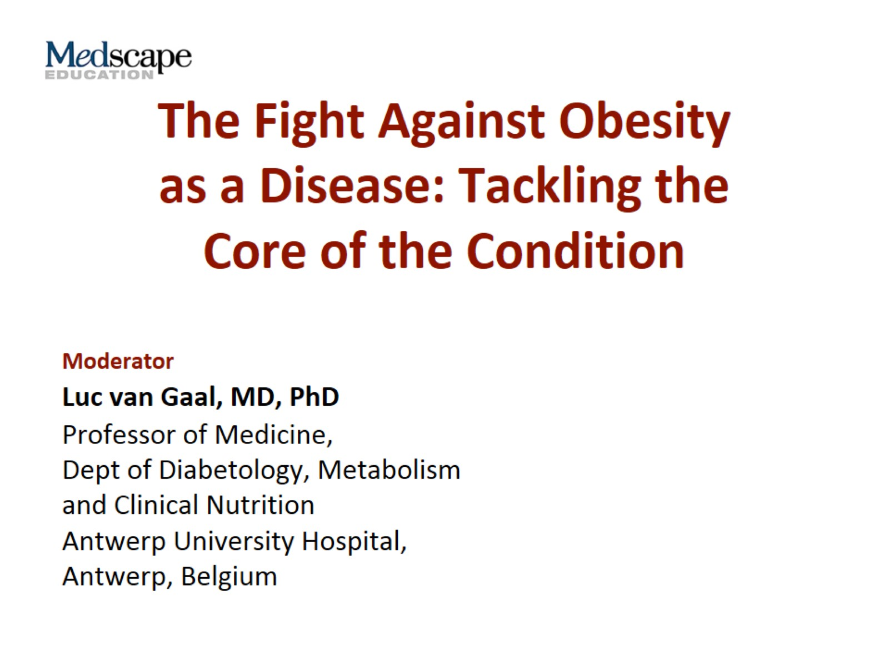
The Fight Against Obesity as a Disease: Tackling the Core of the Condition

Slide 2


Slide 3
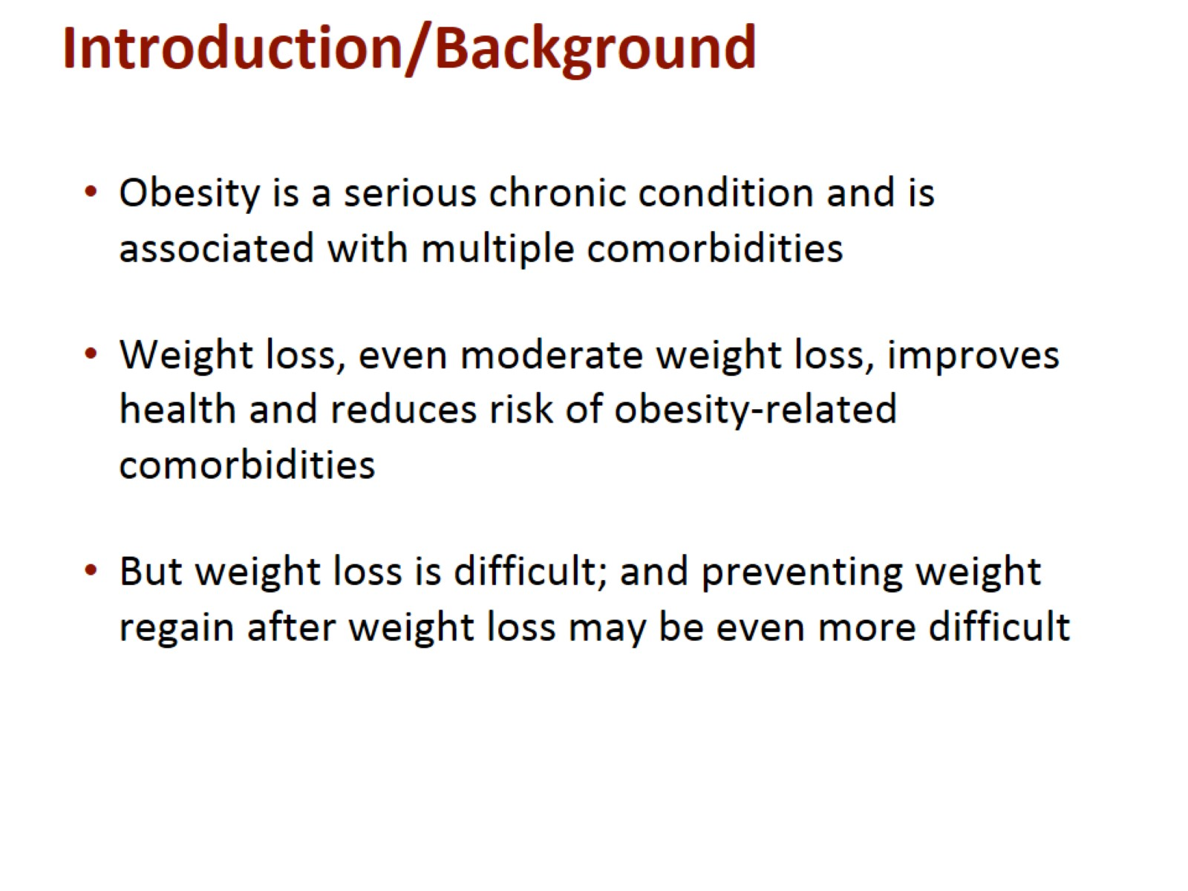
Introduction/Background

Slide 4
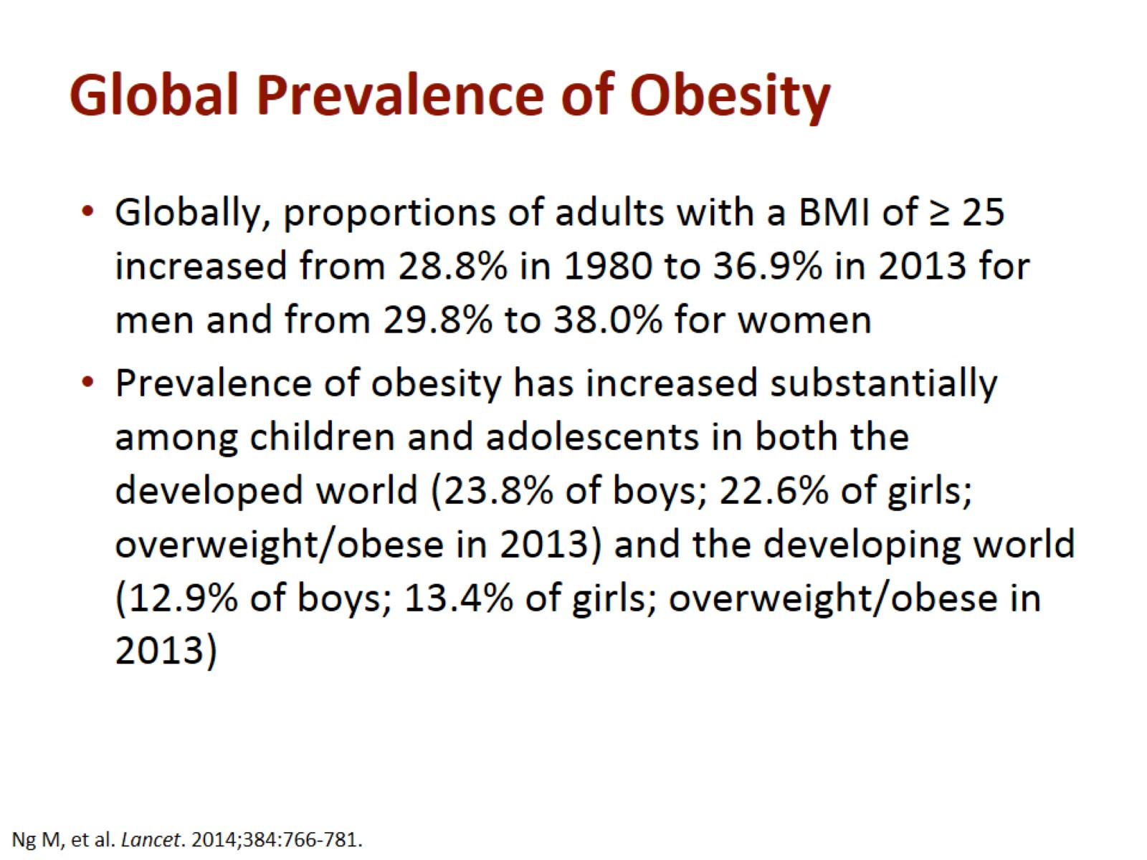
Global Prevalence of Obesity

Slide 5
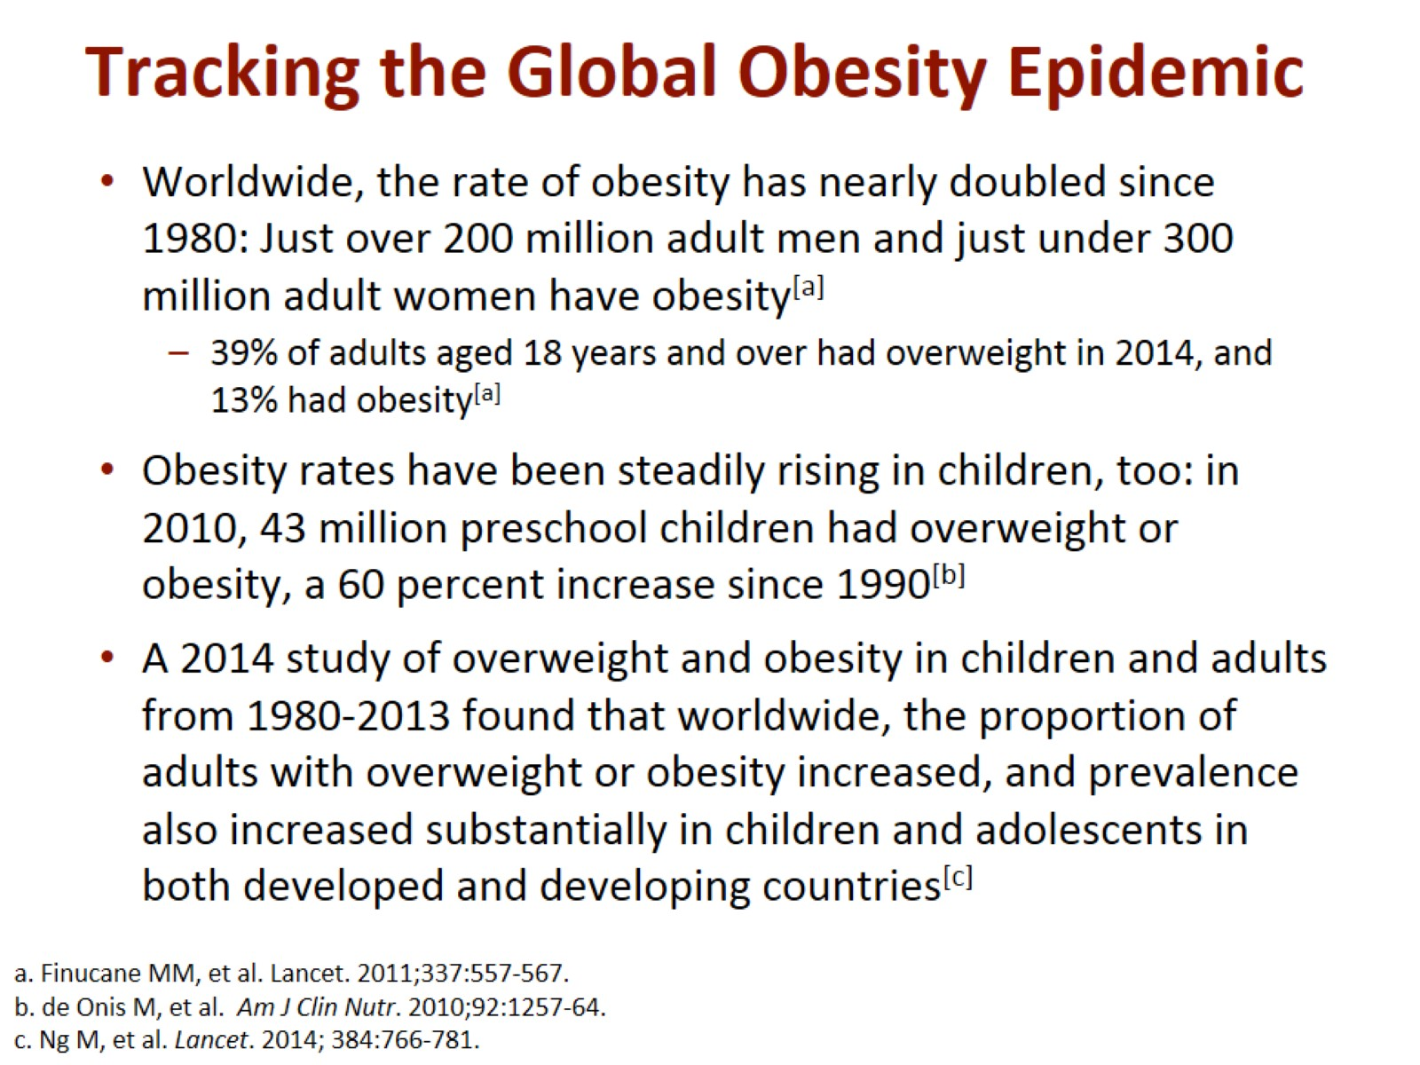
Tracking the Global Obesity Epidemic

Slide 6
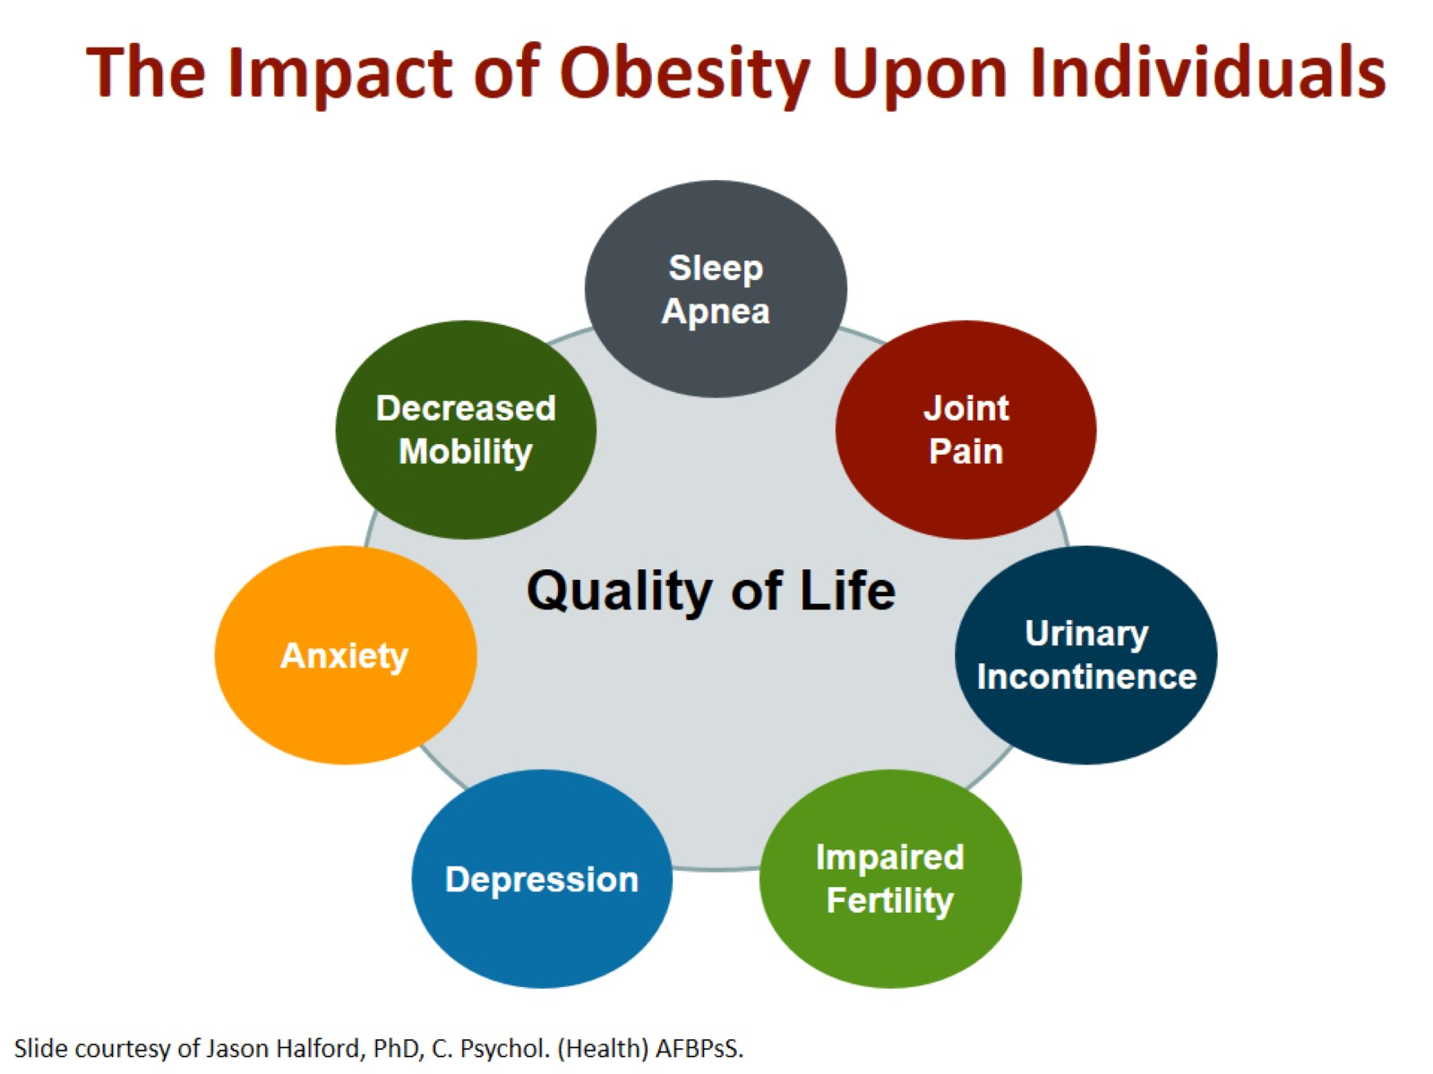
The Impact of Obesity Upon Individuals

Slide 7
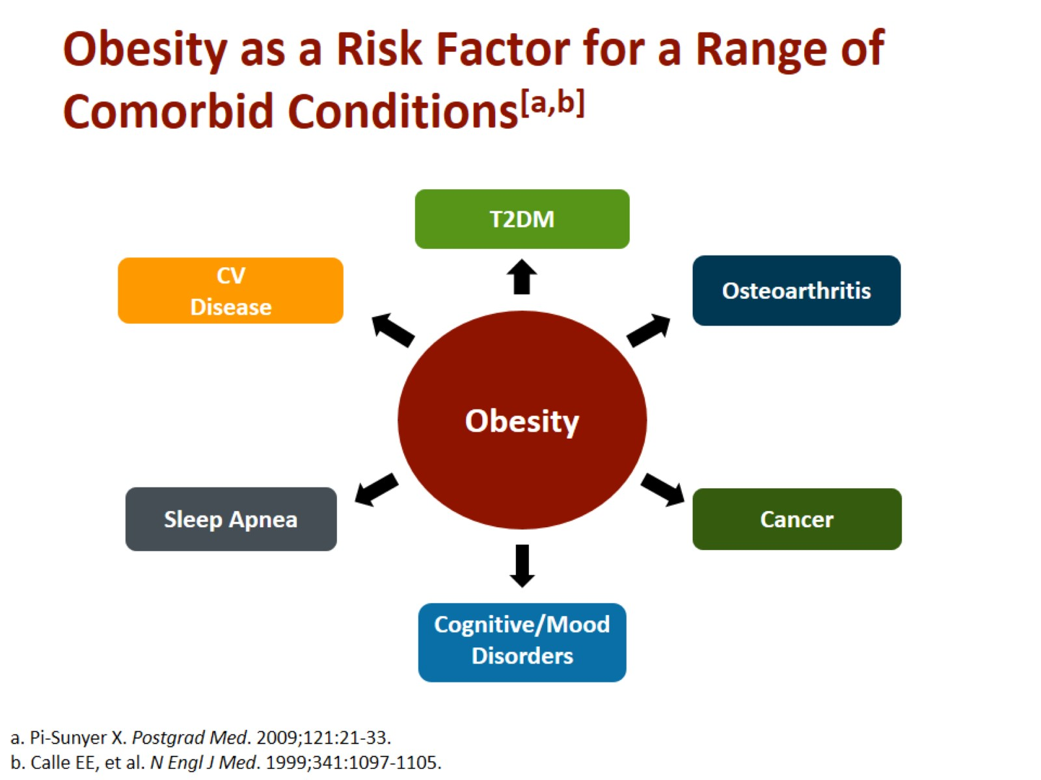
Obesity as a Risk Factor for a Range of Comorbid Conditions^{[a,b]}

Slide 8
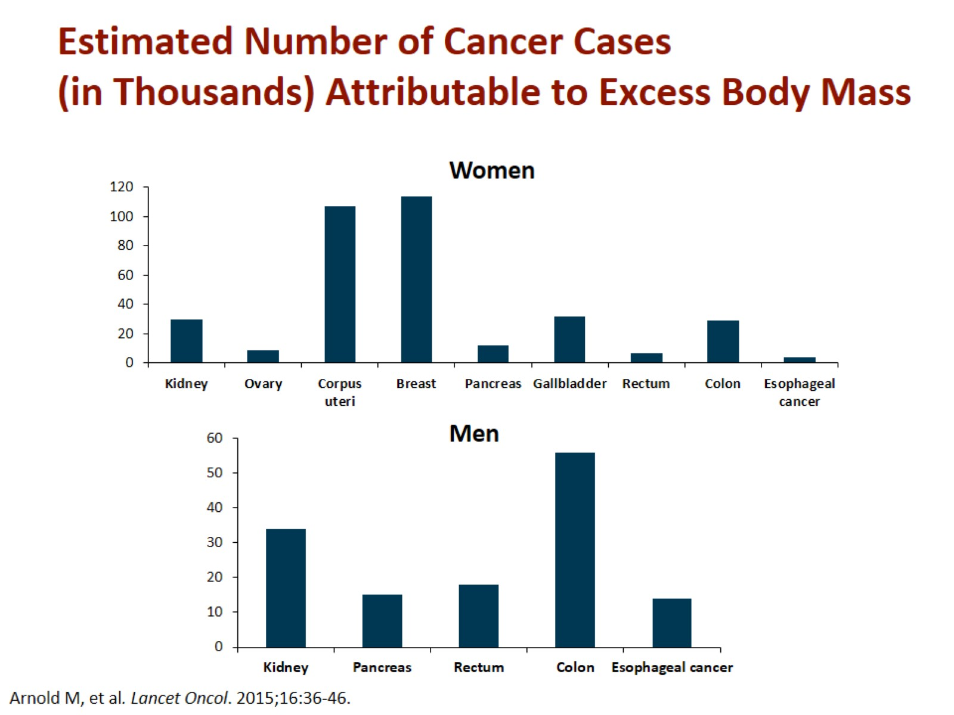
Estimated Number of Cancer Cases (in Thousands) Attributable to Excess Body Mass

Slide 9
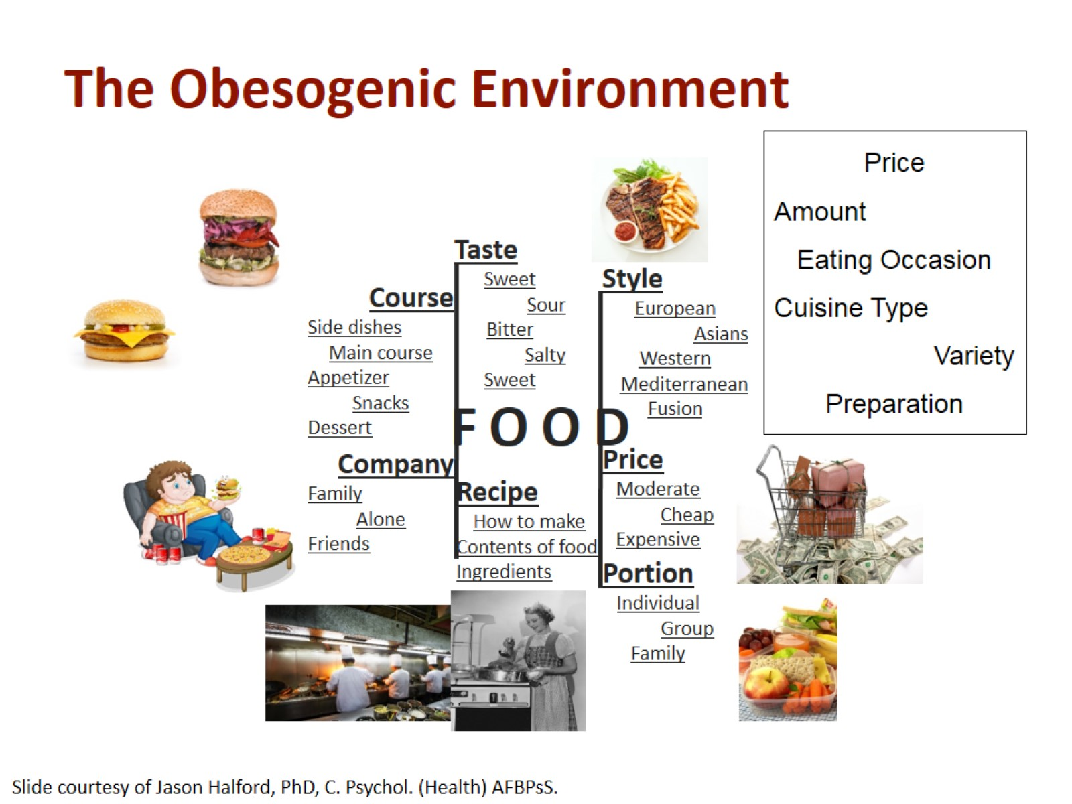
The Obesogenic Environment

Slide 10
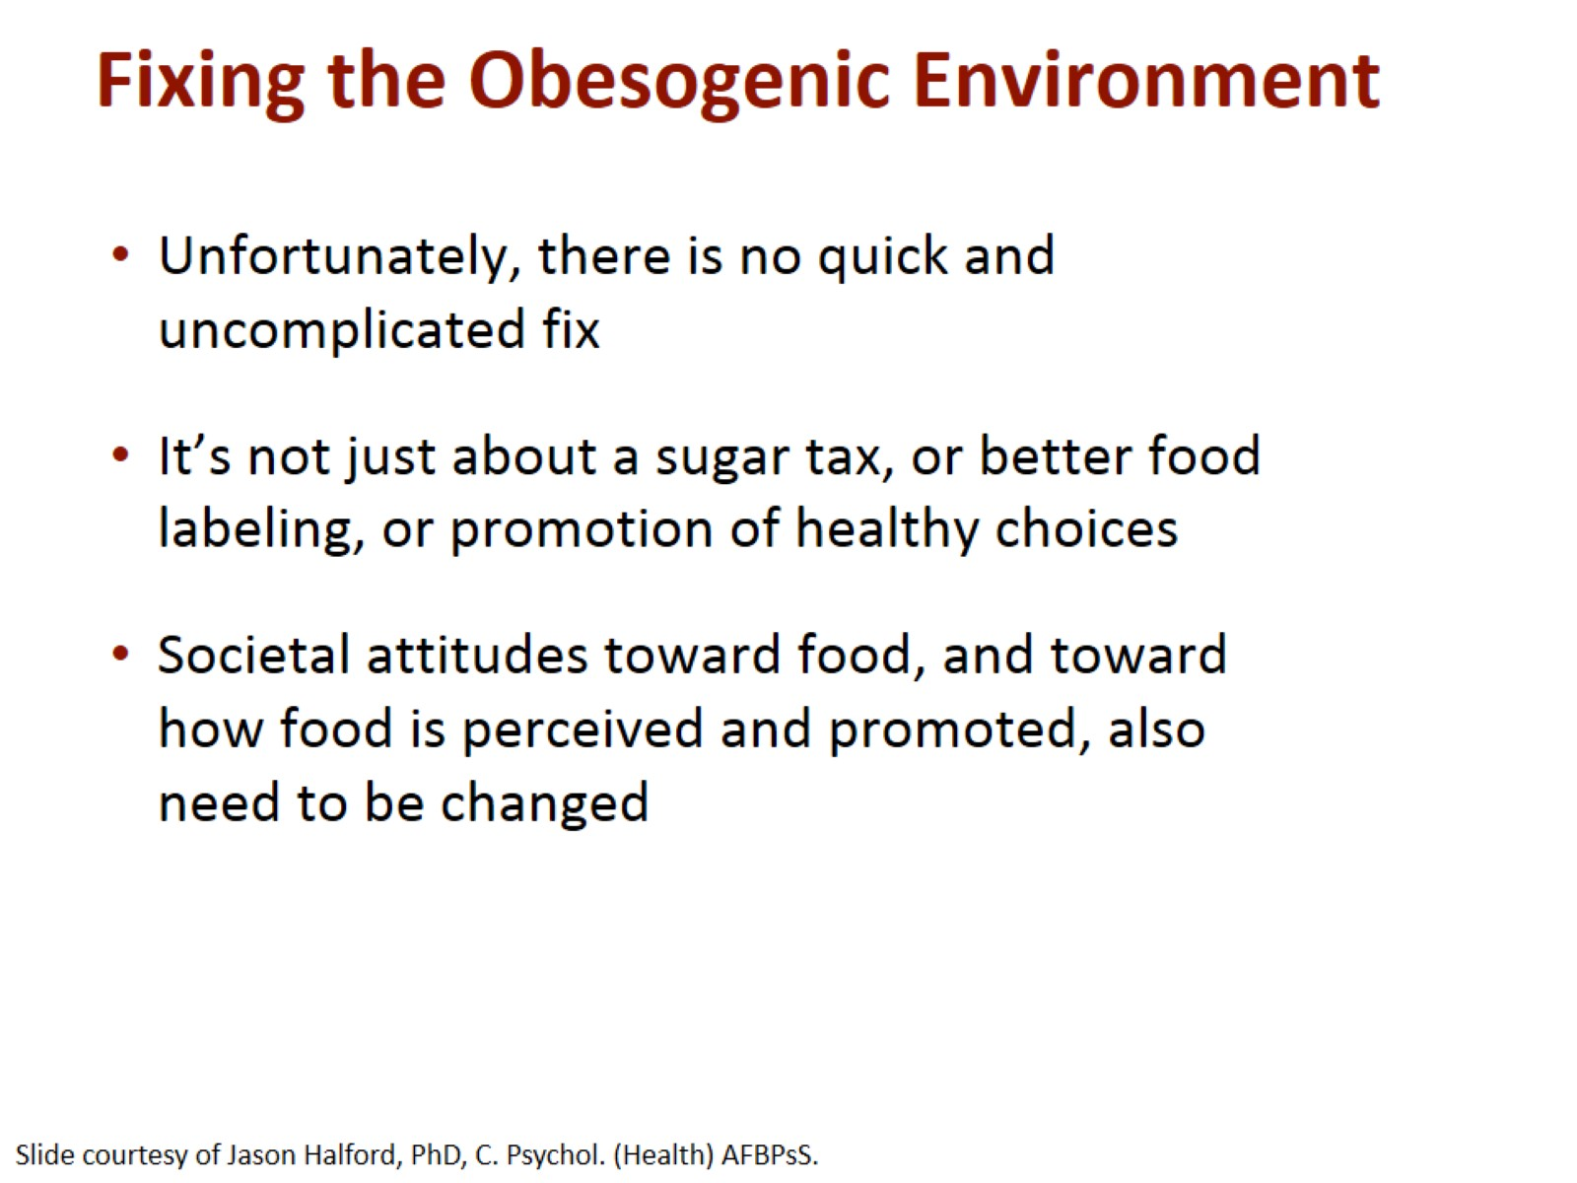
Fixing the Obesogenic Environment

Slide 11
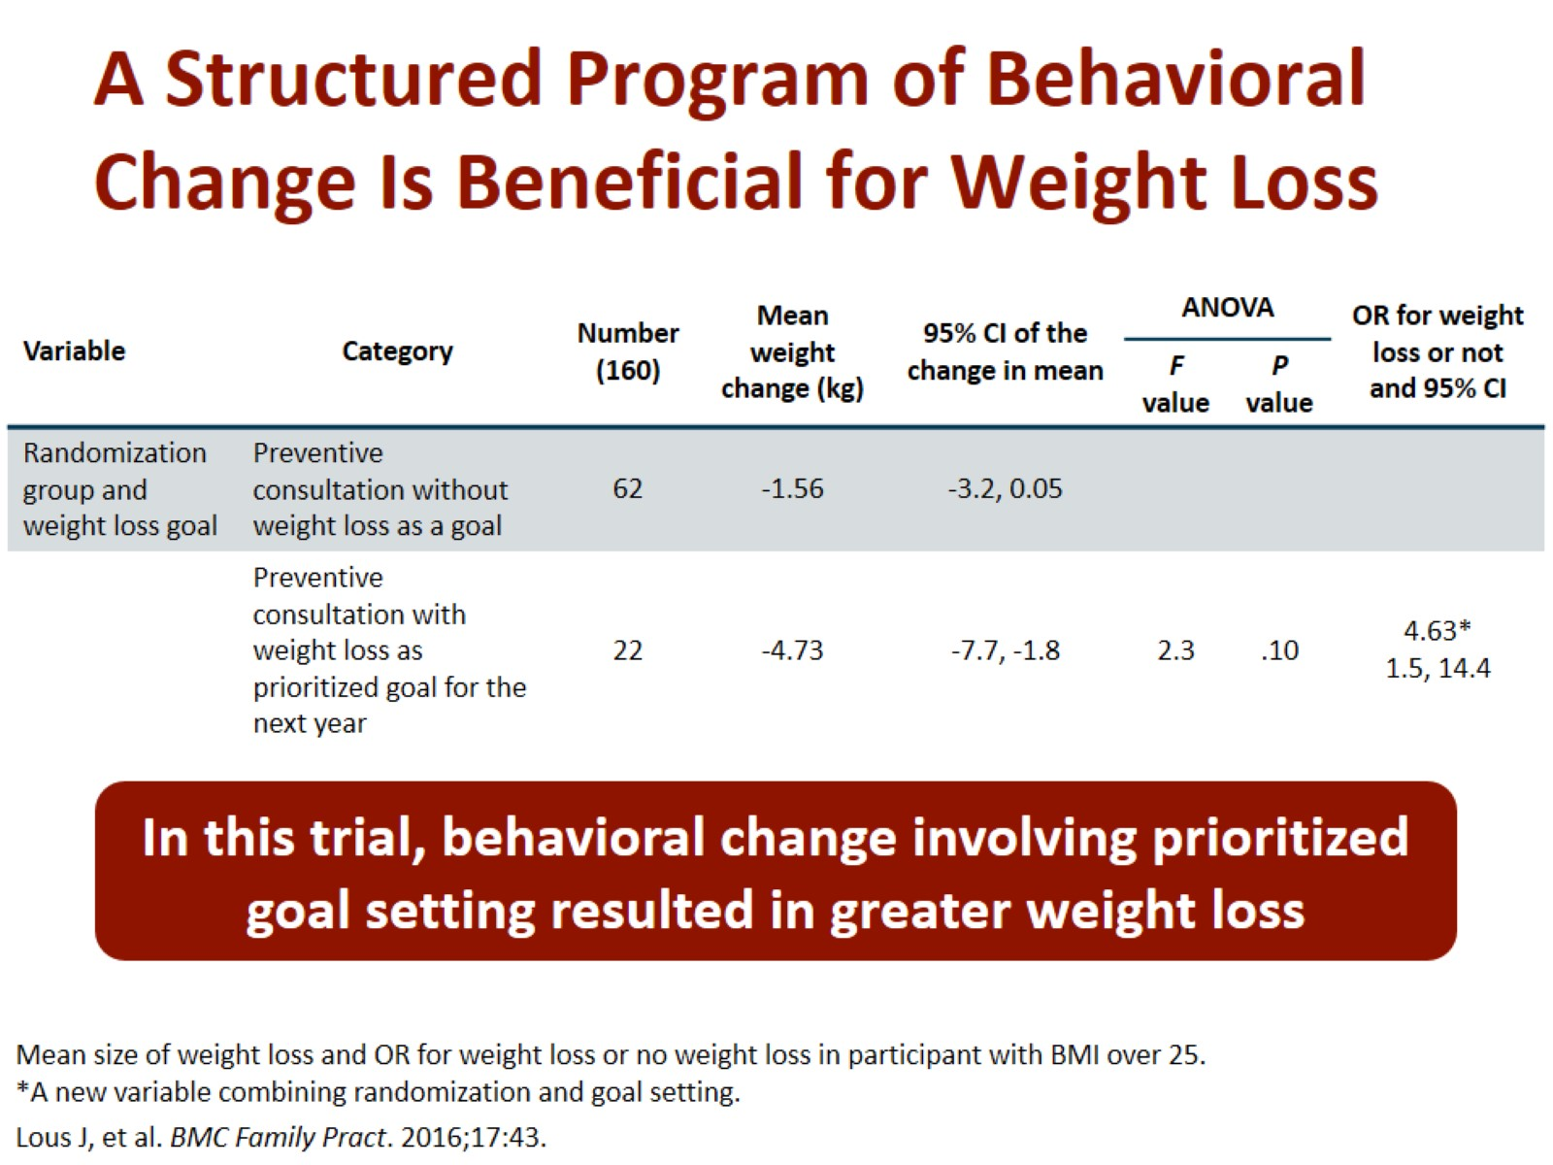
A Structured Program of Behavioral Change Is Beneficial for Weight Loss

Slide 12
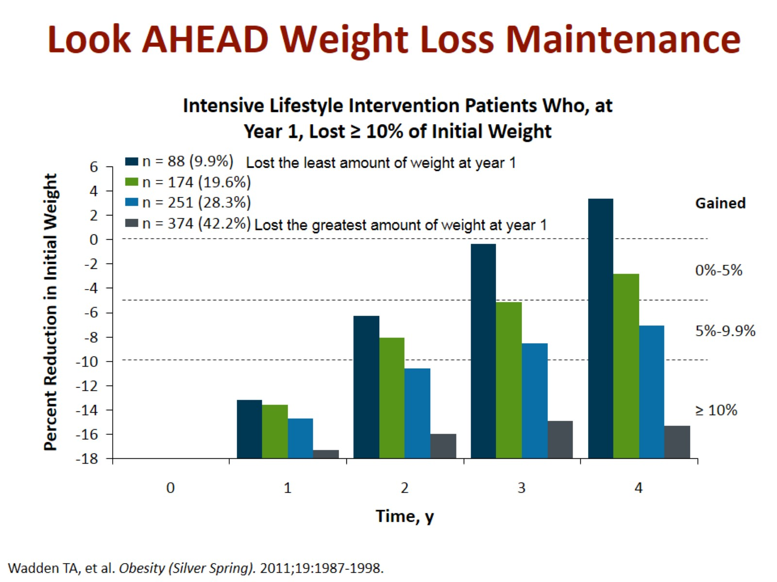
Look AHEAD Weight Loss Maintenance

Slide 13
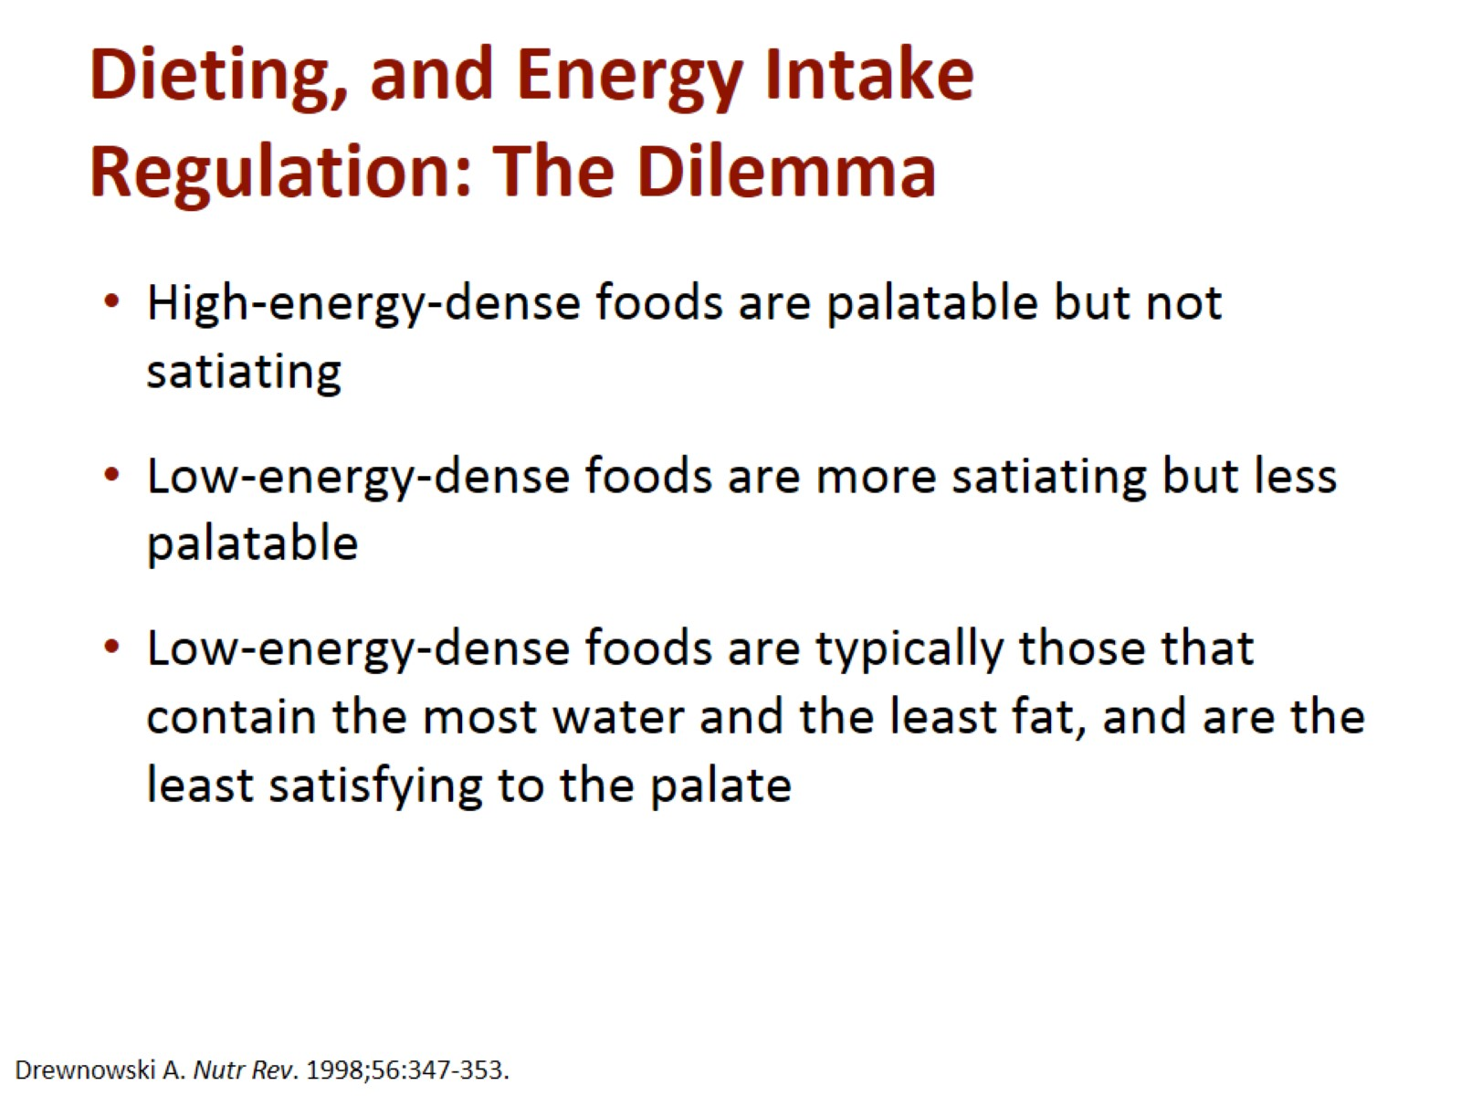
Dieting, and Energy Intake Regulation: The Dilemma

Slide 14
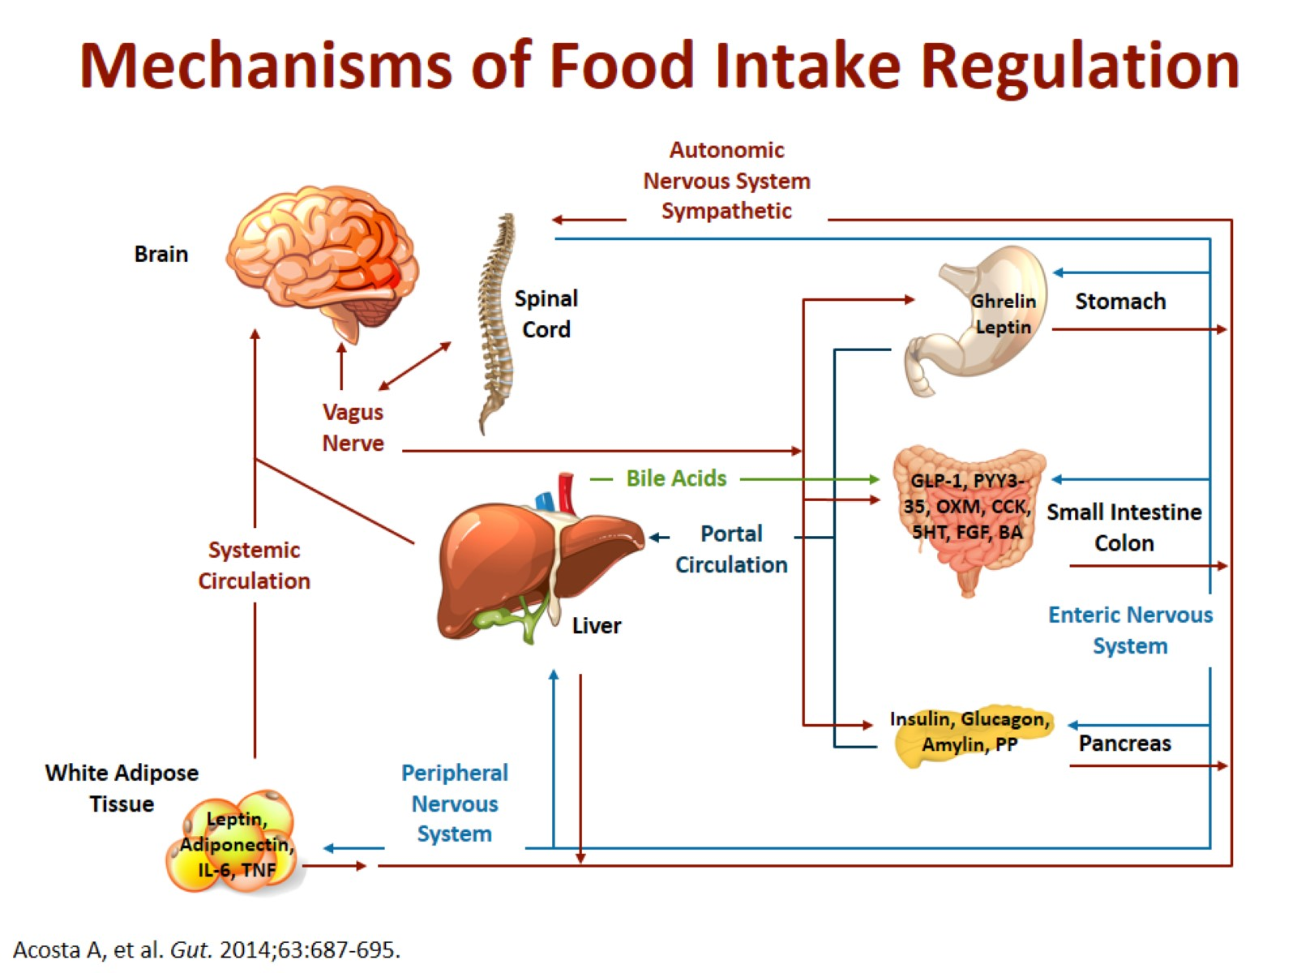
Mechanisms of Food Intake Regulation

Slide 15
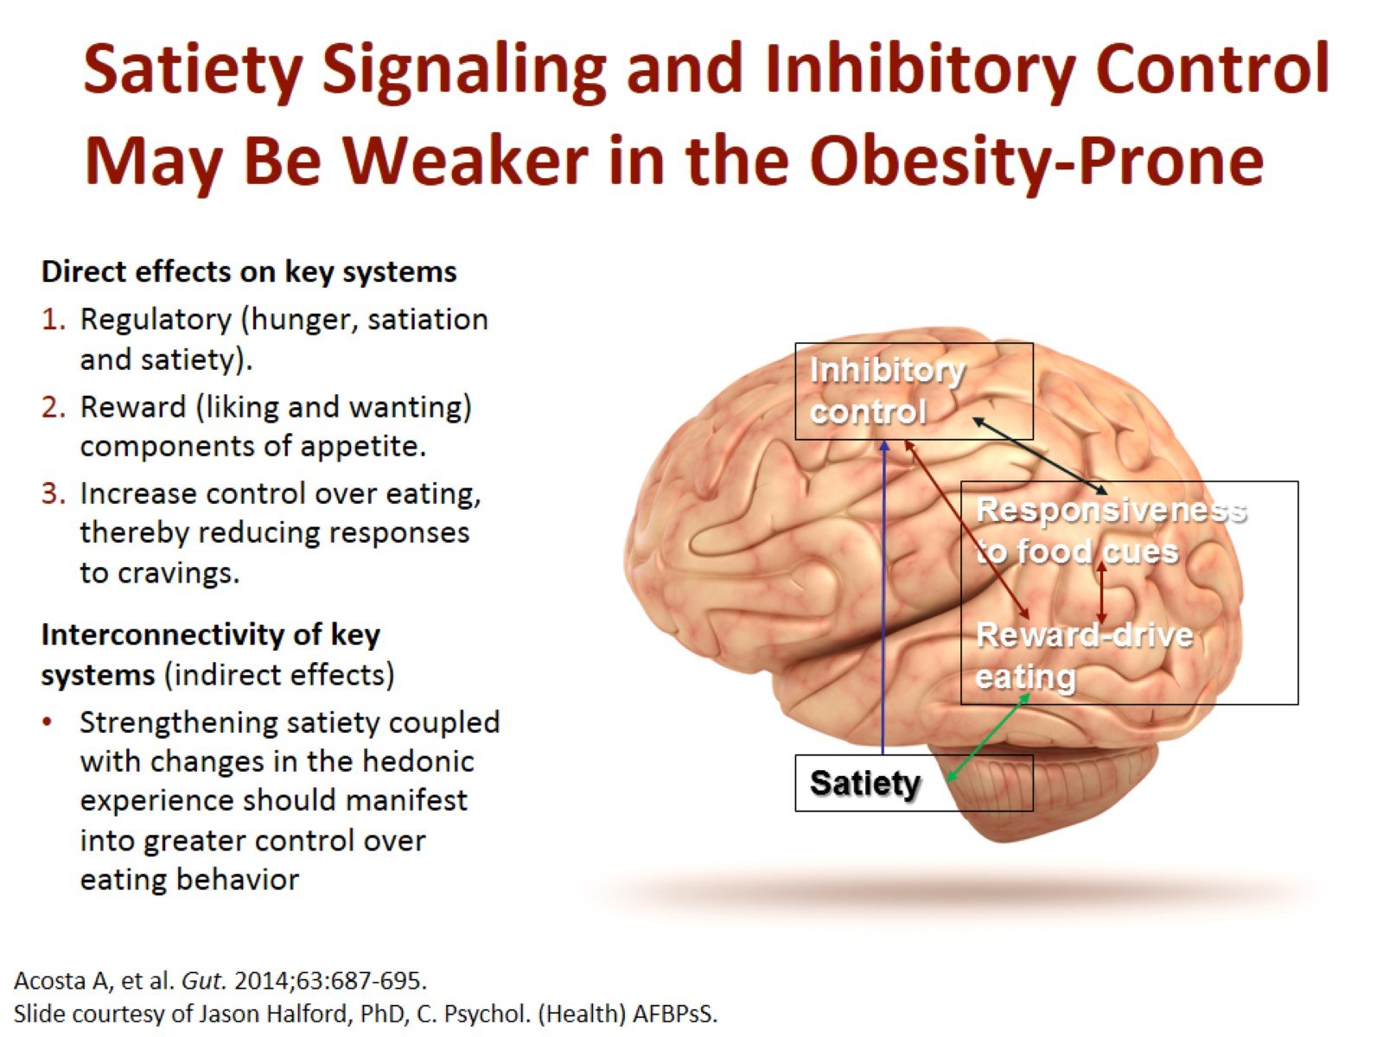
Satiety Signaling and Inhibitory Control May Be Weaker in the Obesity-Prone

Slide 16
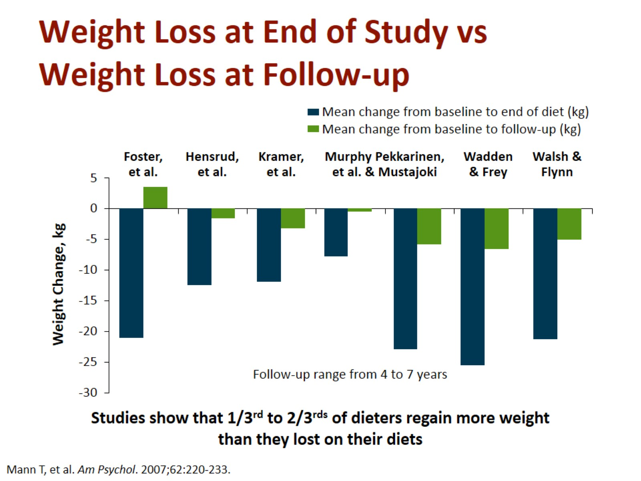
Weight Loss at End of Study vs Weight Loss at Follow-up

Slide 17
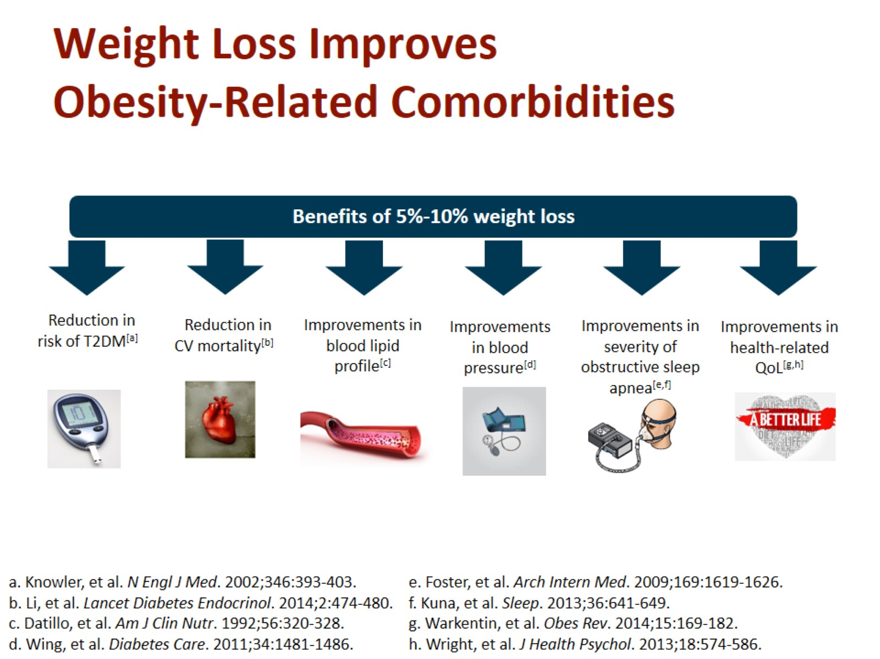
Weight Loss Improves Obesity-Related Comorbidities

Slide 18
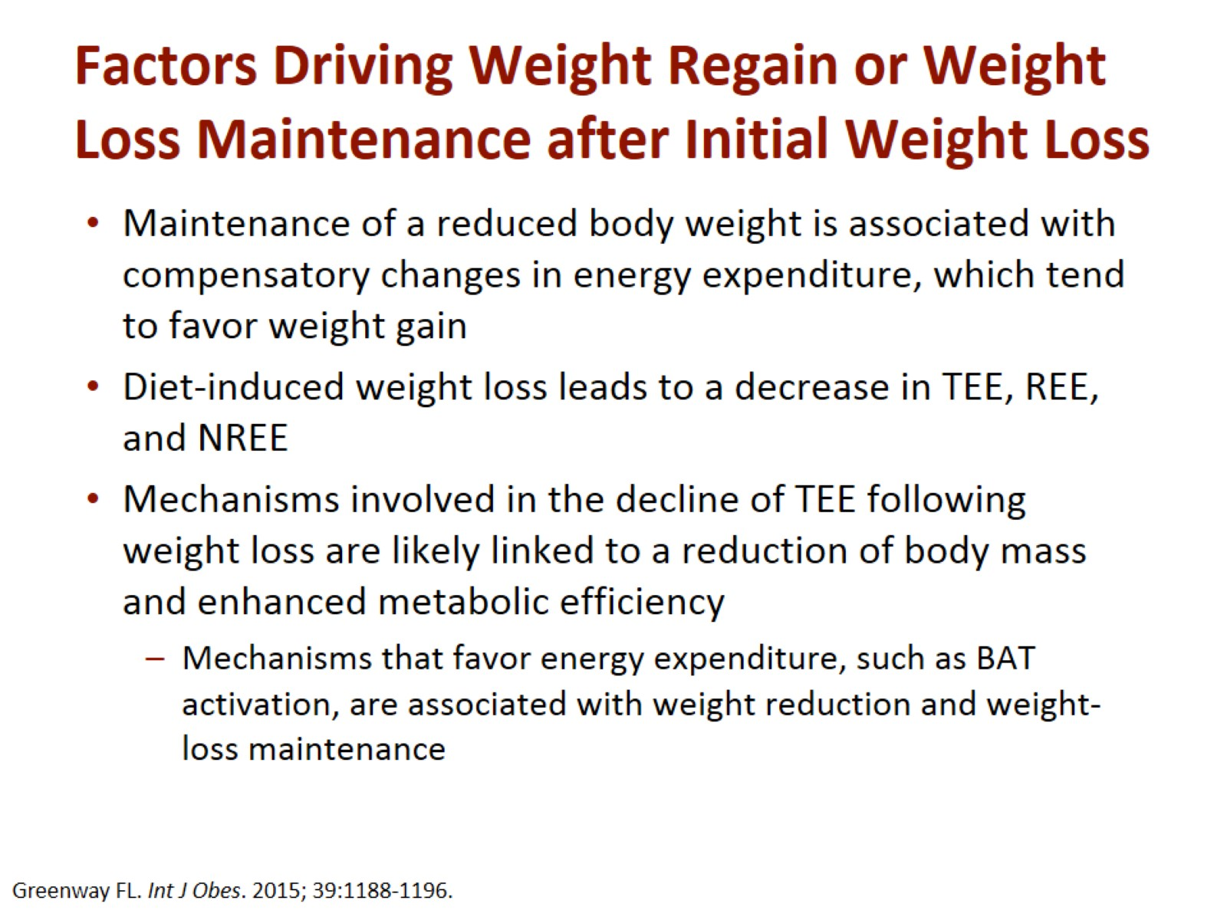
Factors Driving Weight Regain or Weight Loss Maintenance after Initial Weight Loss

Slide 19
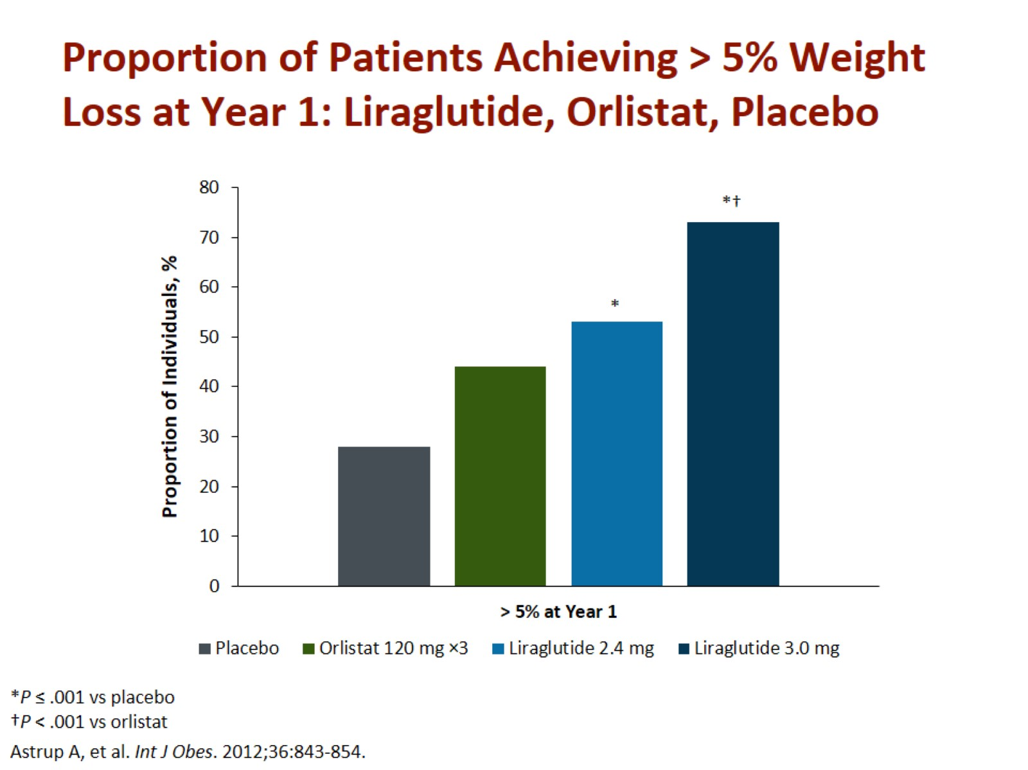
Proportion of Patients Achieving > 5% Weight Loss at Year 1: Liraglutide, Orlistat, Placebo

Slide 20
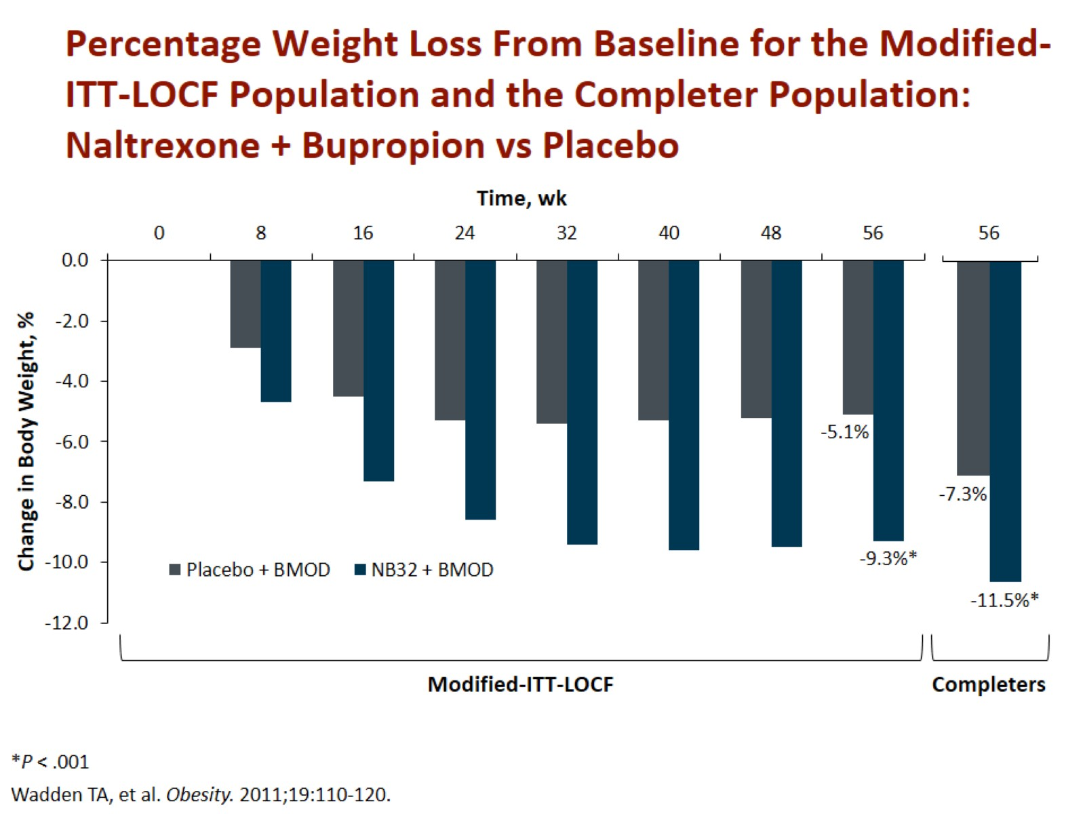
Percentage Weight Loss From Baseline for the Modified-ITT-LOCF Population and the Completer Population: Naltrexone + Bupropion vs Placebo

Slide 21
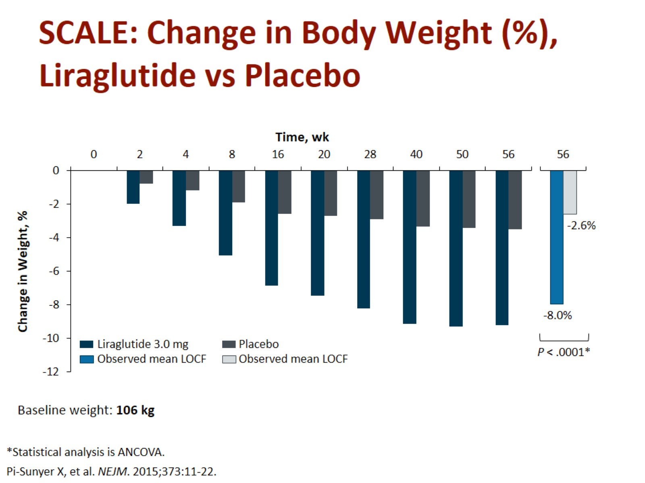
SCALE: Change in Body Weight (%), Liraglutide vs Placebo

Slide 22
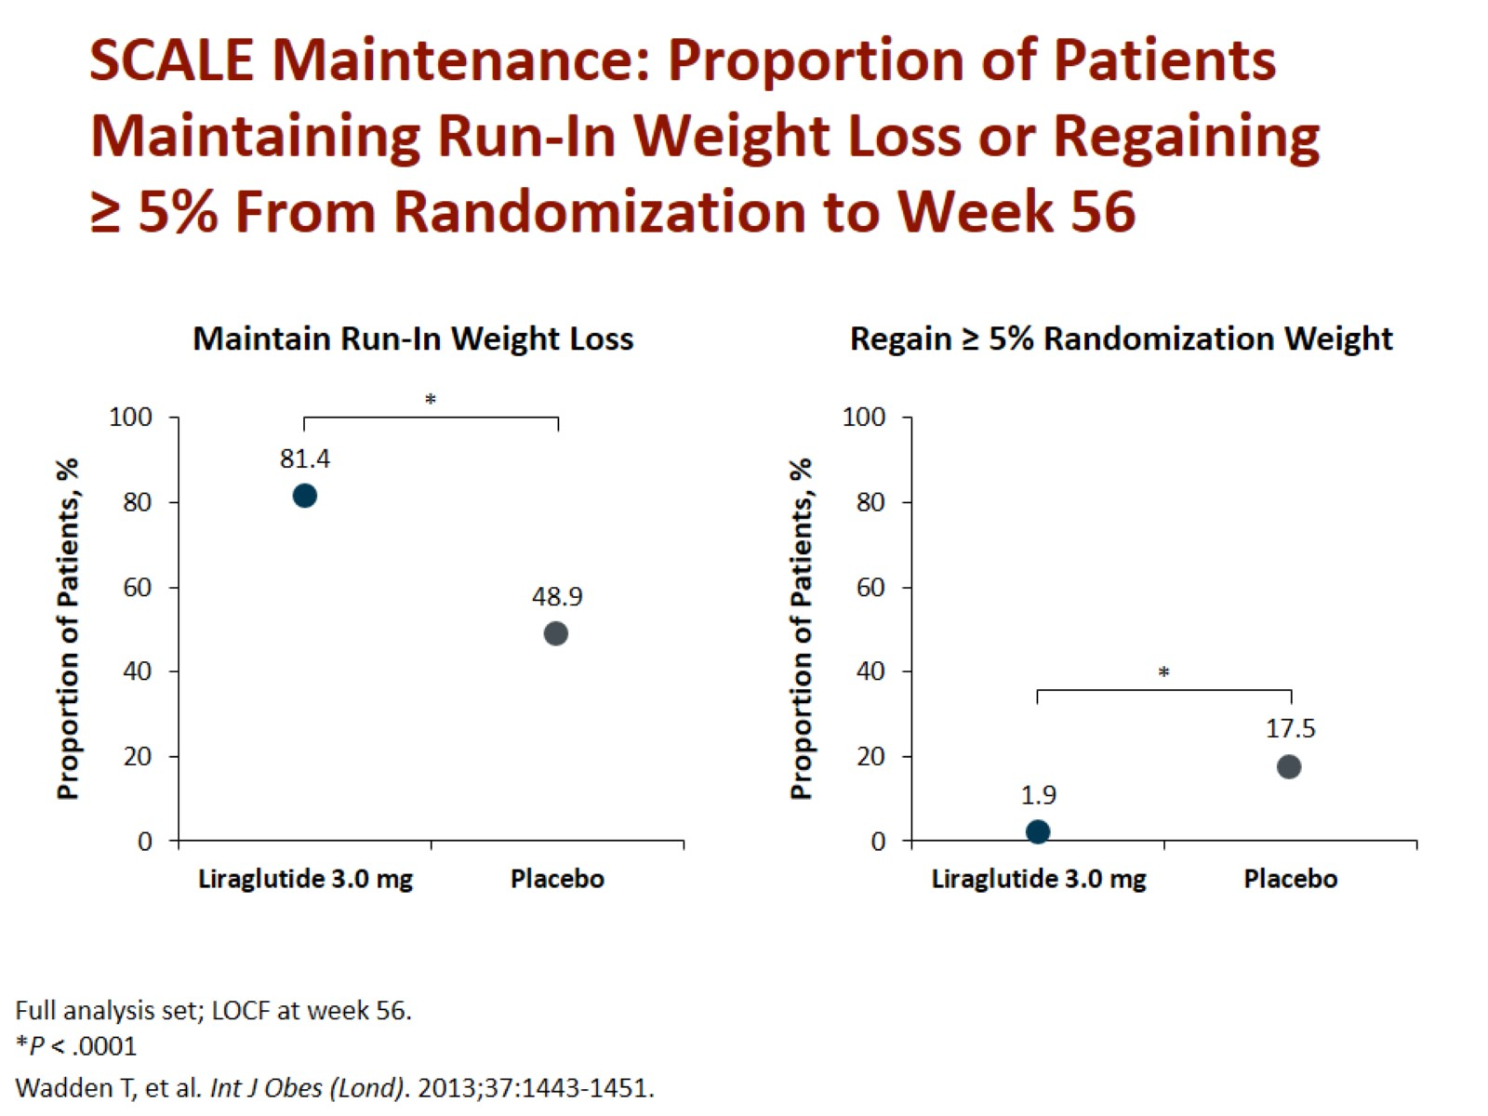
SCALE Maintenance: Proportion of Patients Maintaining Run-In Weight Loss or Regaining ≥ 5% From Randomization to Week 56

Slide 23
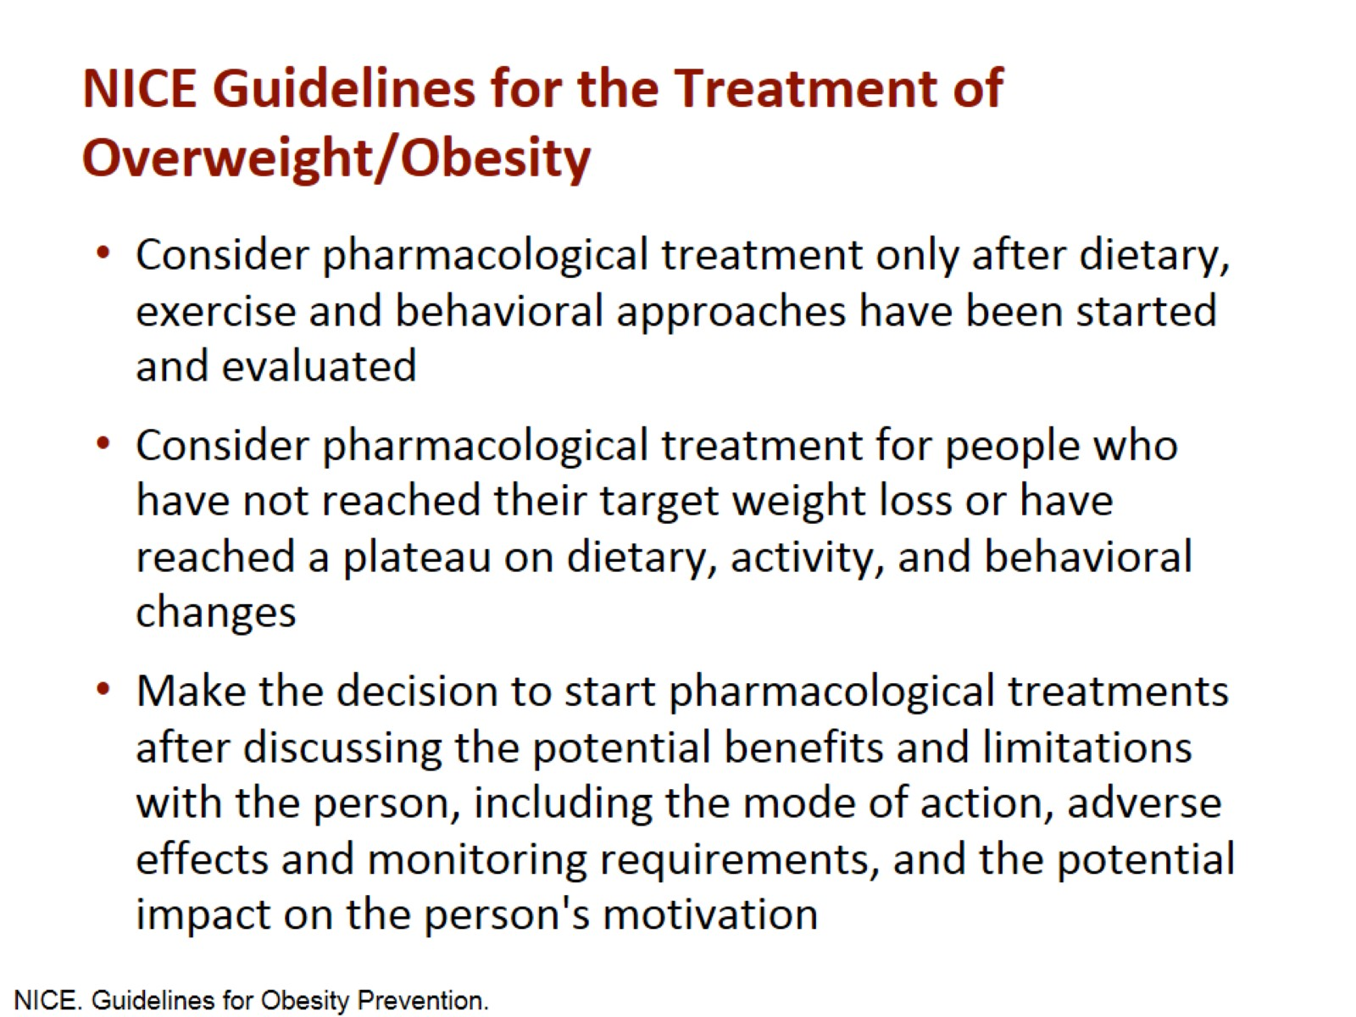
NICE Guidelines for the Treatment of Overweight/Obesity

Slide 24
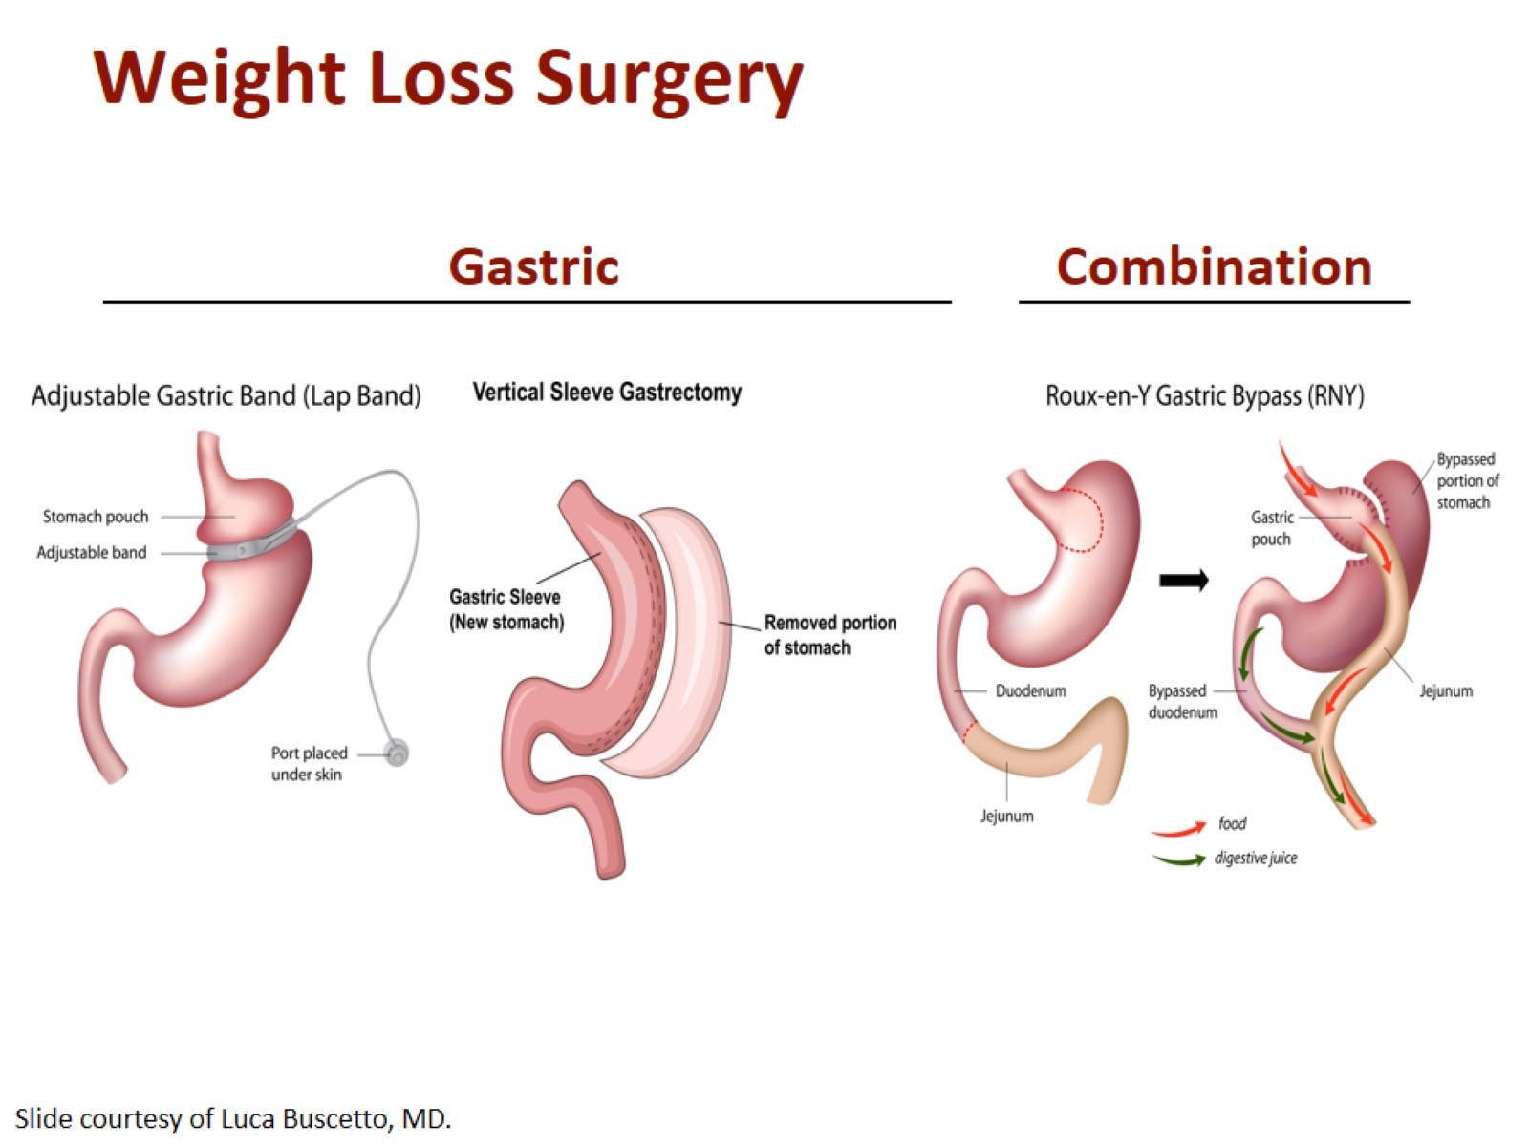
Weight Loss Surgery

Slide 25
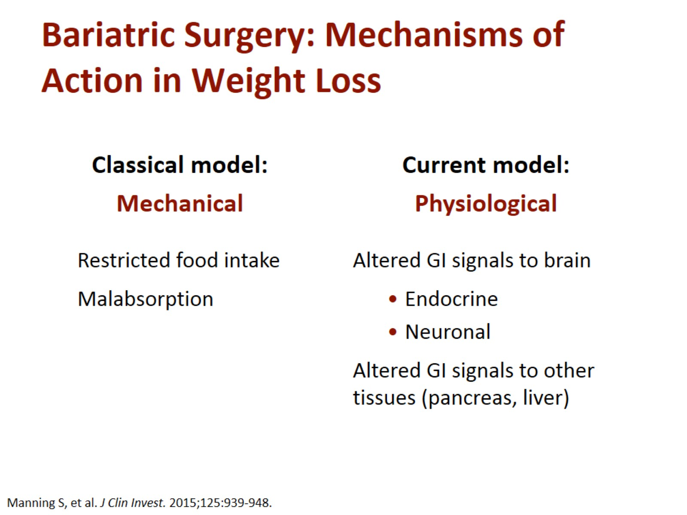
Bariatric Surgery: Mechanisms of Action in Weight Loss

Slide 26
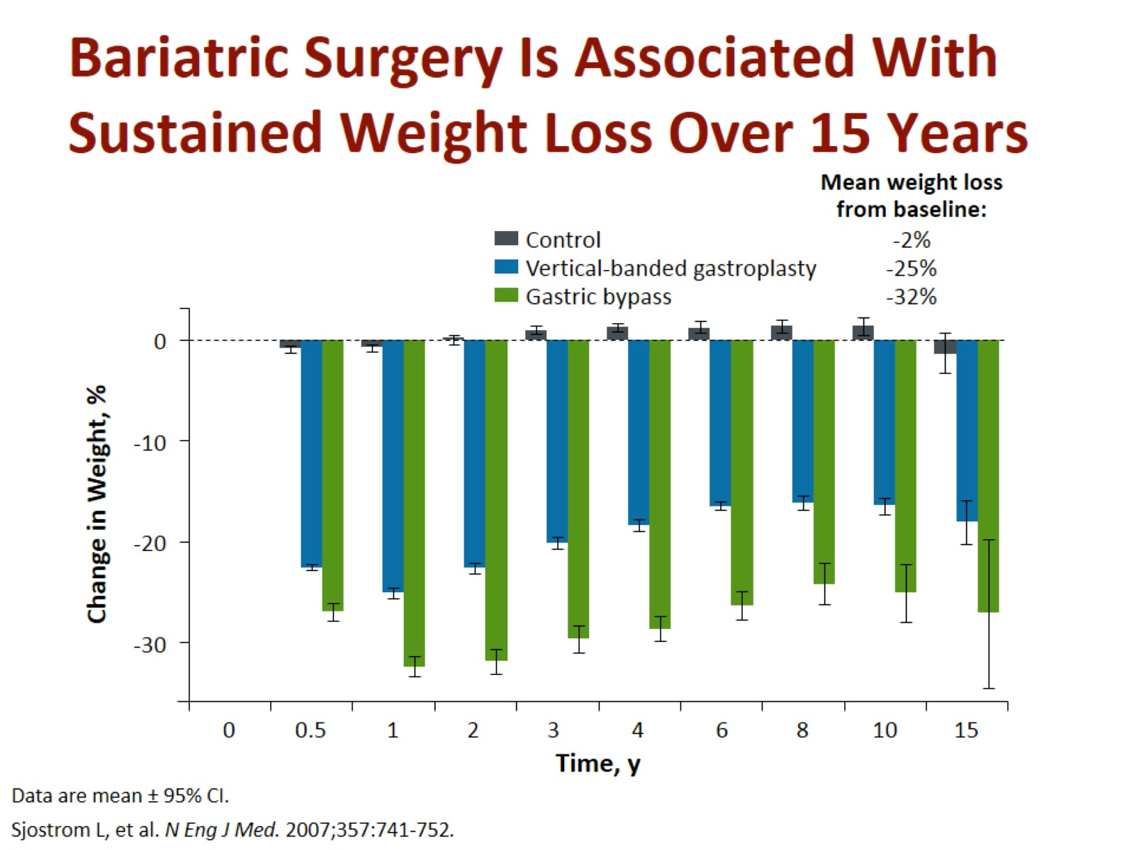
Bariatric Surgery Is Associated With Sustained Weight Loss Over 15 Years

Slide 27
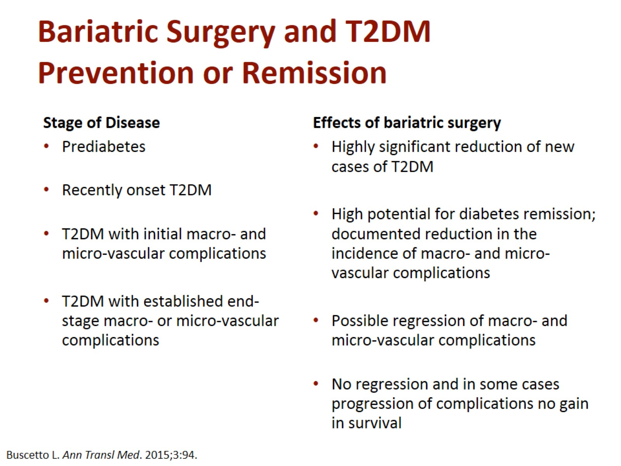
Bariatric Surgery and T2DM Prevention or Remission

Slide 28
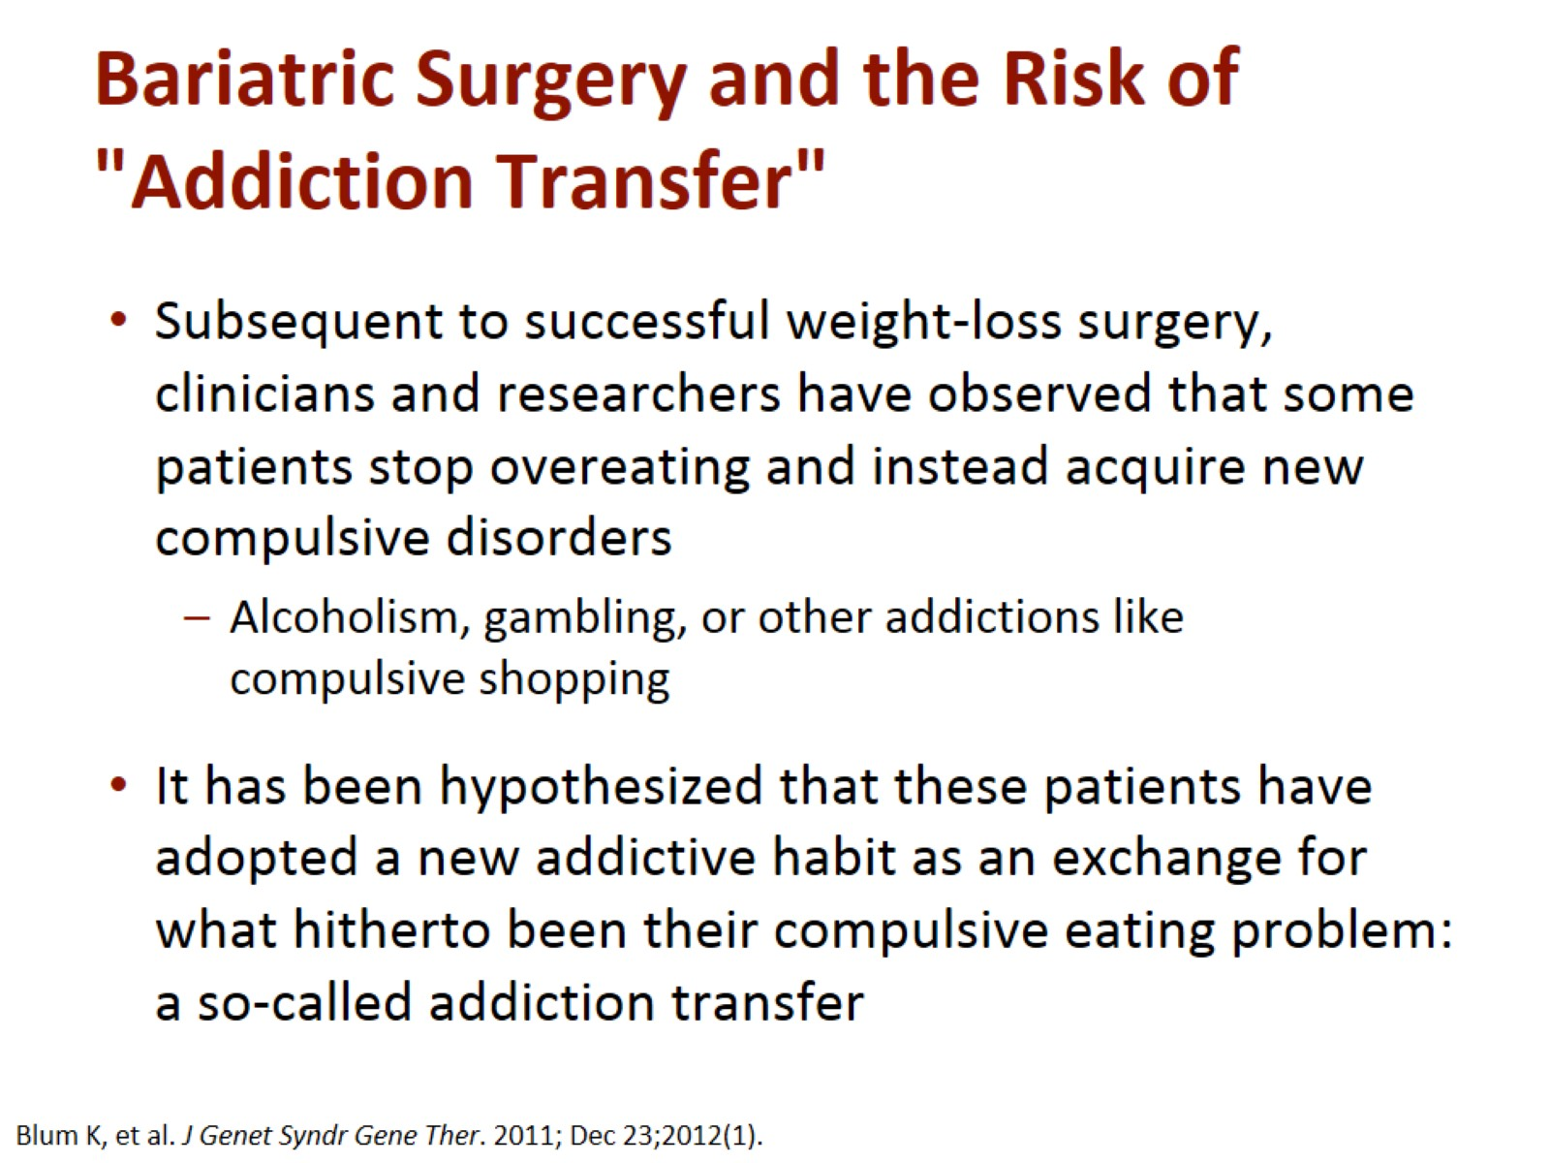
Bariatric Surgery and the Risk of "Addiction Transfer"

Slide 29
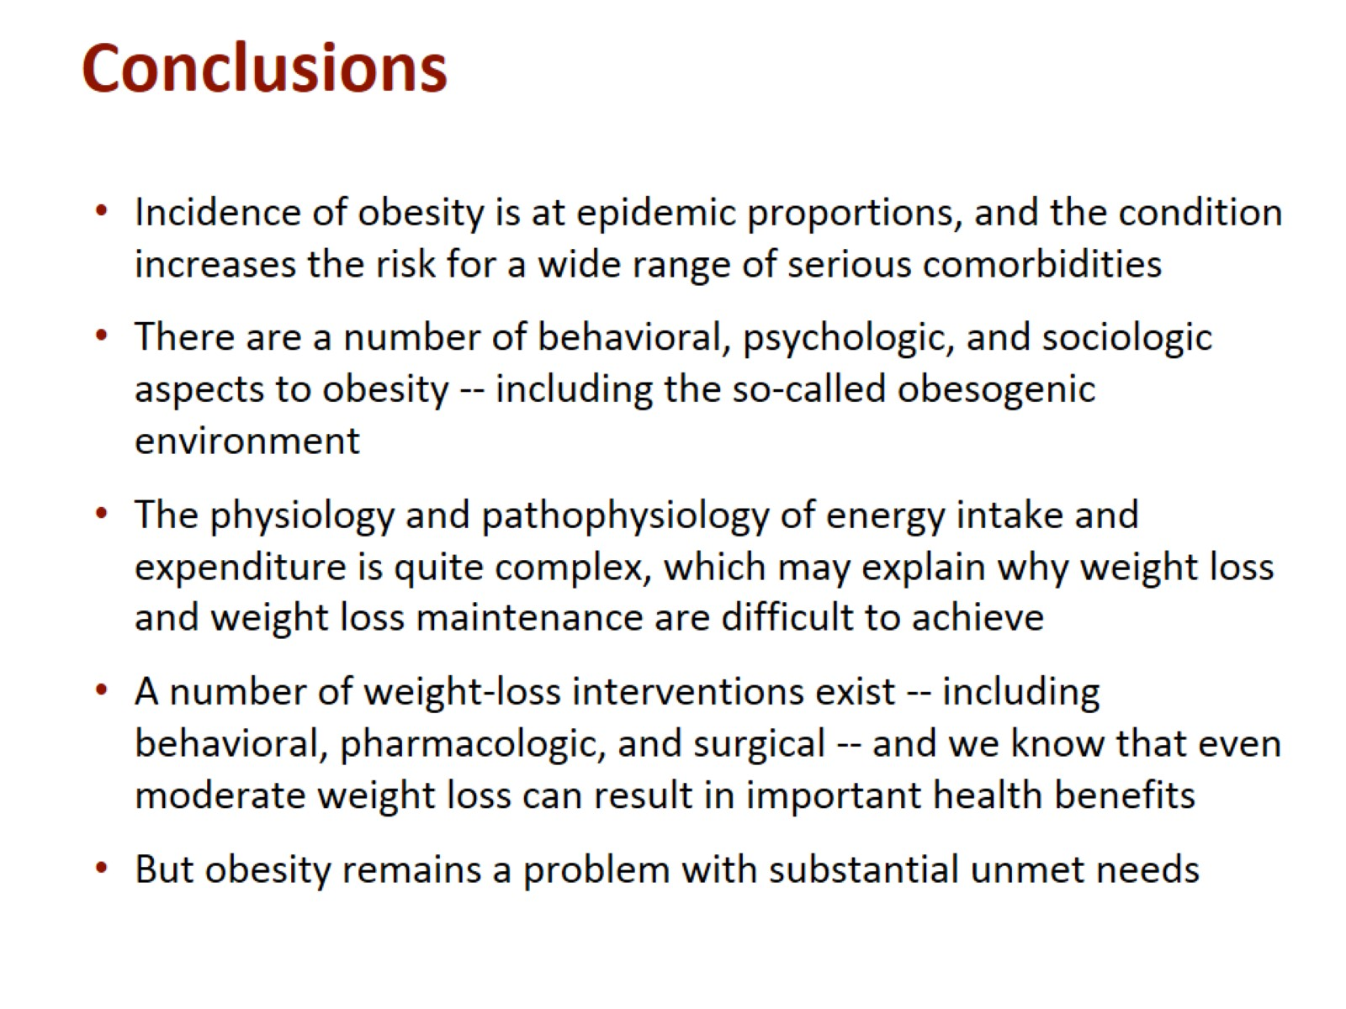
Conclusions

Slide 30
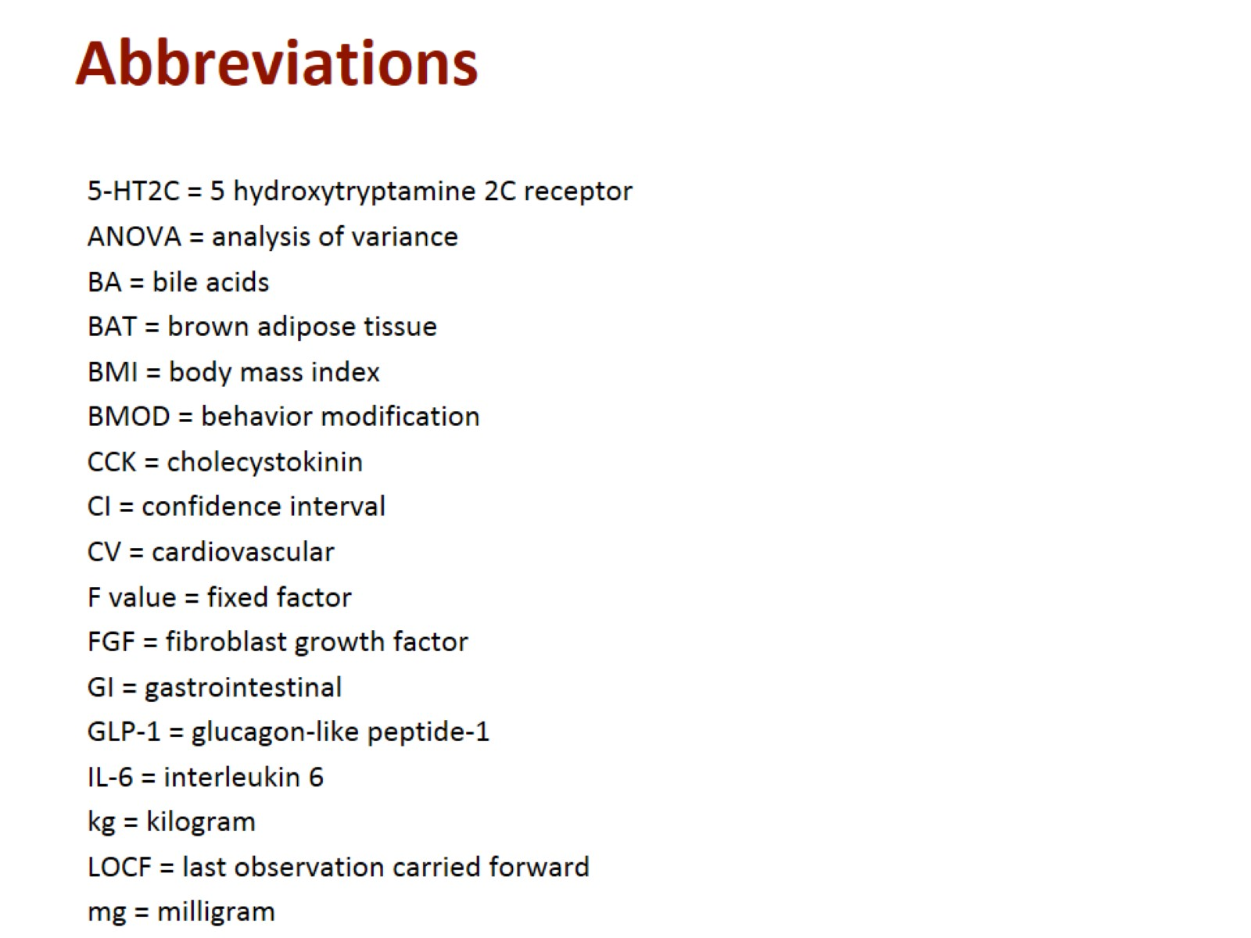
Abbreviations

Slide 31
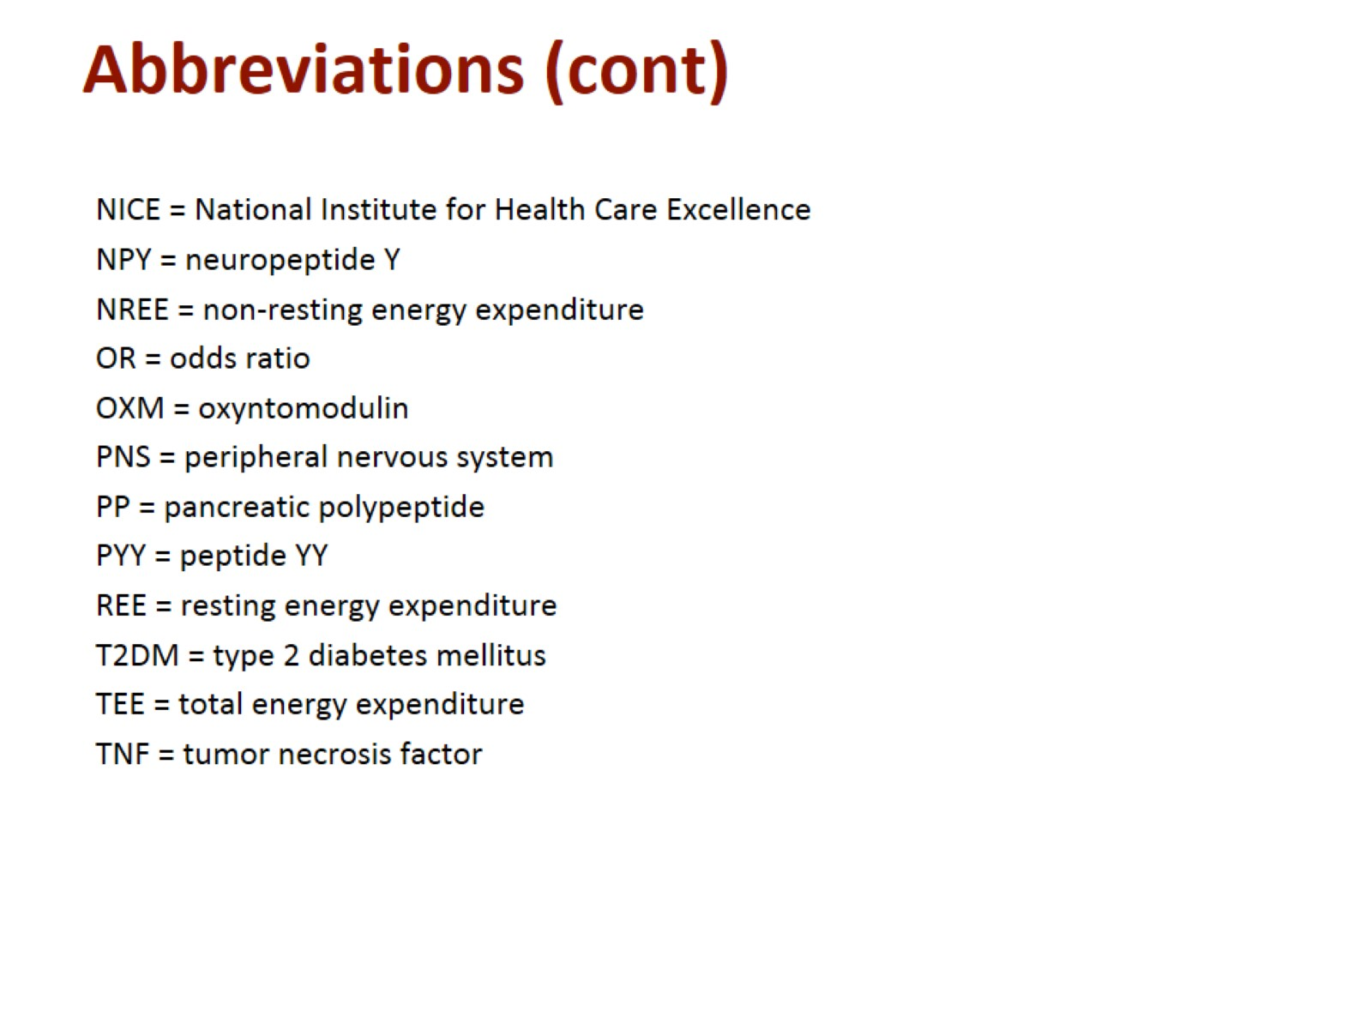
Abbreviations (cont)

